Slide 1
Poetry

Slide 2

What is Poetry?
Poetry is a tool for dependency management and packaging in Python. It allows you to declare the libraries your project depends on and it will manage (install/update) them for you. Poetry offers a lockfile to ensure repeatable installs, and can build your project for distribution.

Slide 3
Basic usage of Poetry

Slide 4
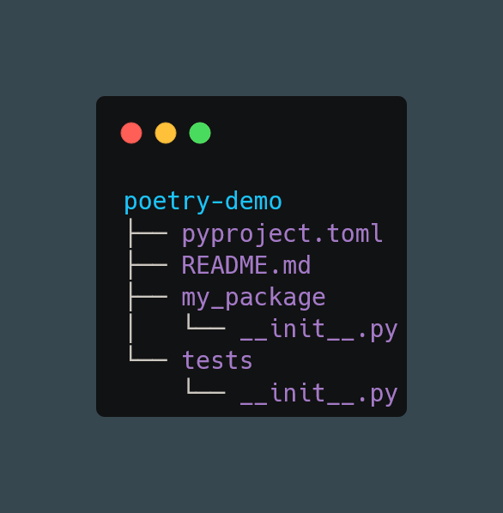
poetry new my-package

Slide 5
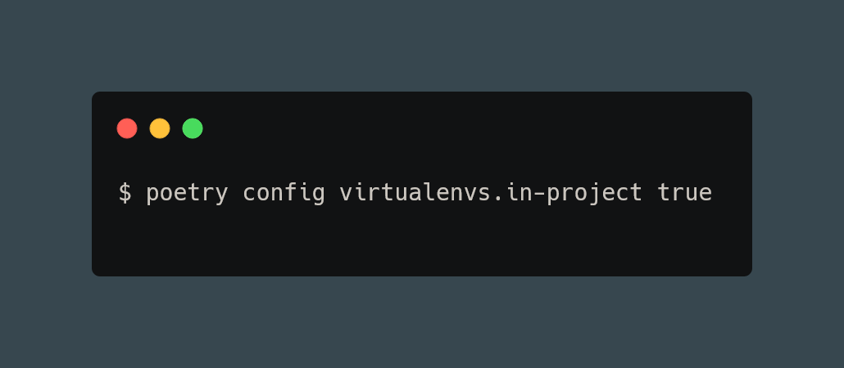
poetry new my-package

Slide 6
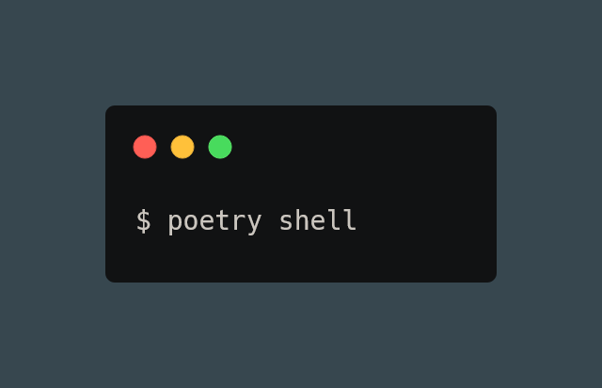
poetry shell

Slide 7
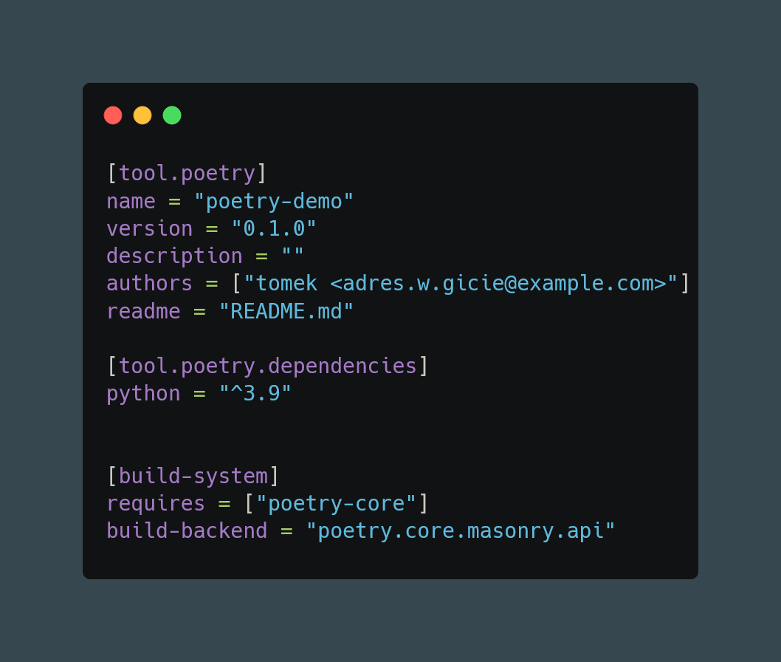
pyproject.toml

Slide 8
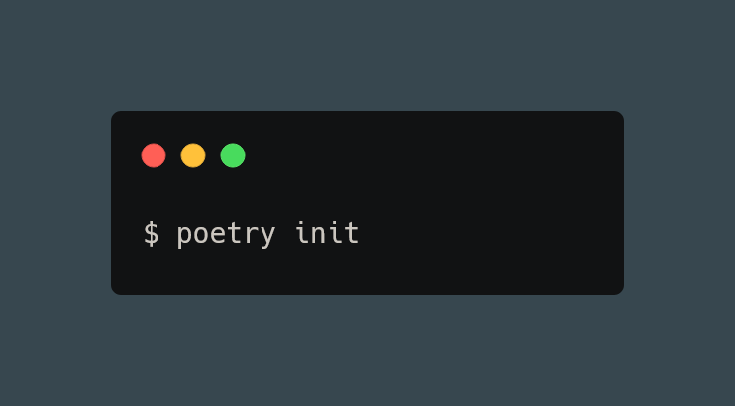
poetry init
Instead of creating a new project, Poetry can be used to ‘initialise’ a pre-populated directory.
To interactively create a pyproject.toml for a project, use:

Slide 9
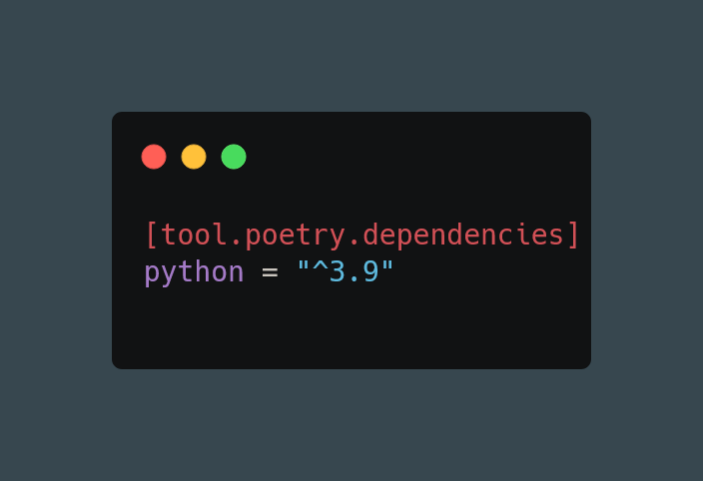
Dependency specification
adding dependencies manually in pyproject.toml file
poetry add package-name (defaults to latest version)

Slide 10
Versioning

Slide 11
Caret requirements
An update is allowed if the new version number does not modify the left-most non-zero digit in the major, minor, patch grouping

Slide 12
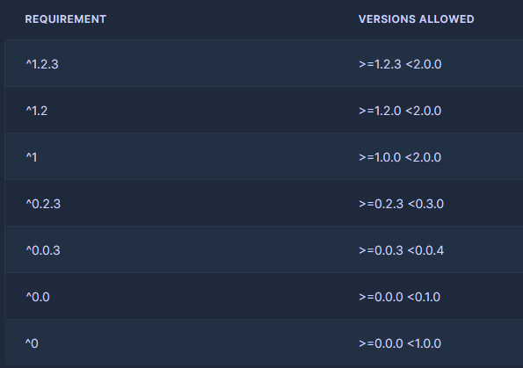
Caret requirements

Slide 13
Tilde requirements
Tilde requirements specify a minimal version with some ability to update.
If you specify a major, minor, and patch version or only a major and minor version, only patch-level changes are allowed.
If you only specify a major version, then minor- and patch-level changes are allowed

Slide 14
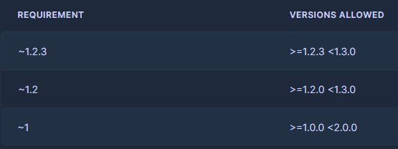
Tilde requirements

Slide 15
Wildcard requirements
Wildcard requirements allow for the latest (dependency dependent) version where the wildcard is positioned

Slide 16
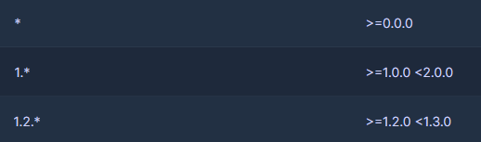
Wildcard requirements

Slide 17
Inequality requirements
Inequality requirements allow manually specifying a version range or an exact version to depend on.

Slide 18
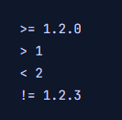
Inequality requirements

Slide 19
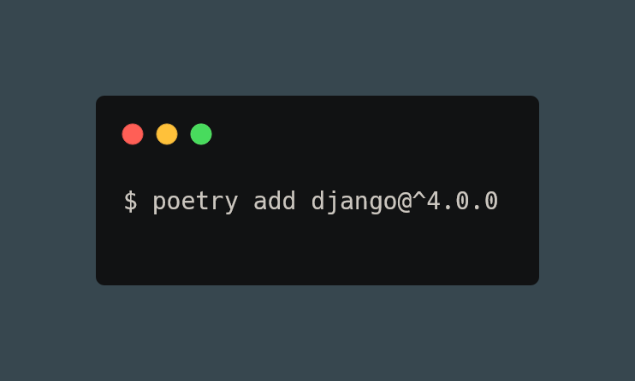
poetry add

Slide 20
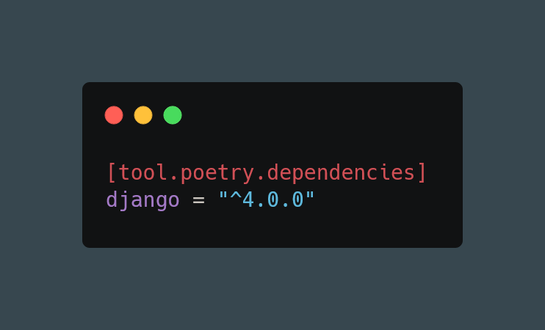
poetry add

Slide 21
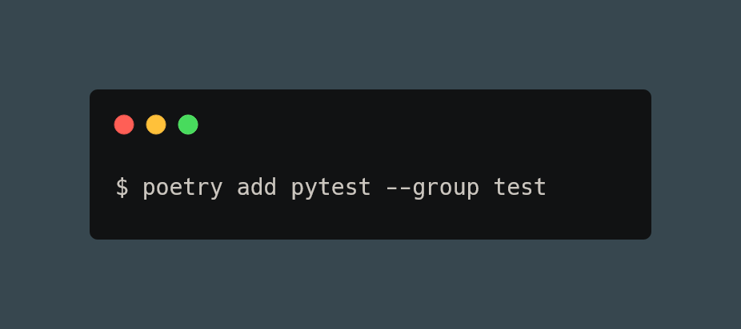
poetry add

Slide 22
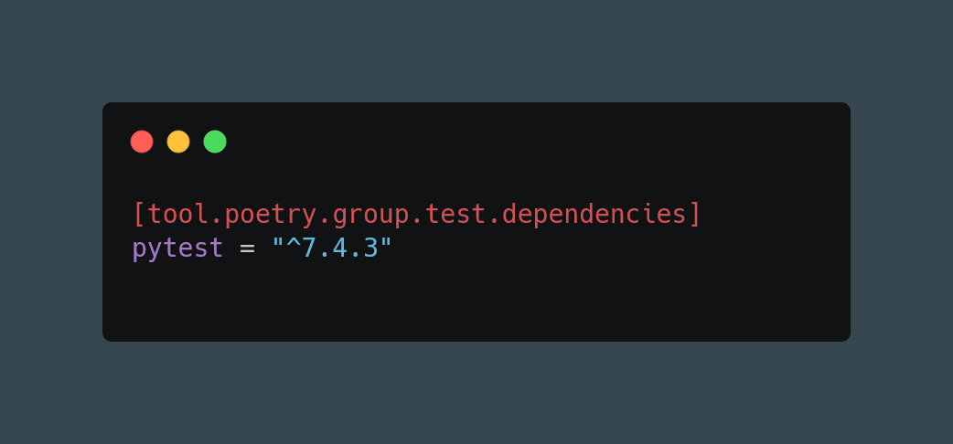
poetry add

Slide 23
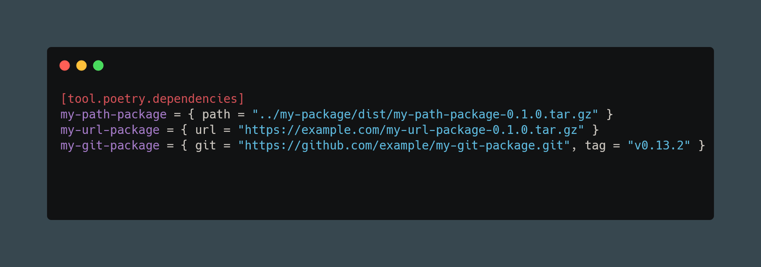
poetry add

Slide 24
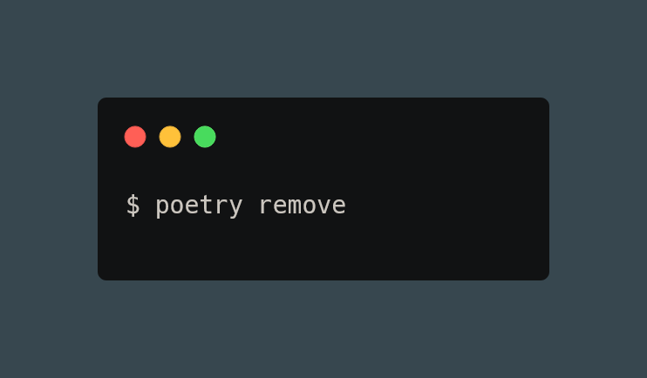
poetry remove

Slide 25
poetry lock
This command locks (without installing) the dependencies specified in pyproject.toml.
By default, this will lock all dependencies to the latest available compatible versions. To only refresh the lock file, use the --no-update option.

Slide 26
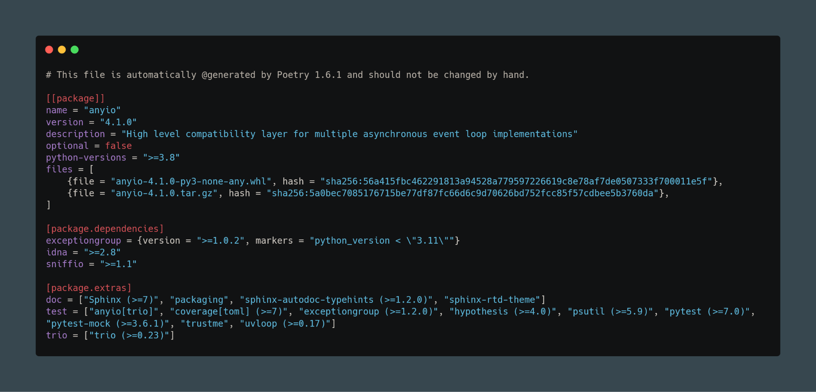
poetry lock
This command locks (without installing) the dependencies specified in pyproject.toml.
By default, this will lock all dependencies to the latest available compatible versions. To only refresh the lock file, use the --no-update option.

Slide 27
poetry install
without poetry.lock
Poetry simply resolves all dependencies listed in your pyproject.toml file and downloads the latest version of their files. When Poetry has finished installing, it writes all the packages and their exact versions that it downloaded to the poetry.lock file, locking the project to those specific versions. You should commit the poetry.lock file to your project repo so that all people working on the project are locked to the same versions of dependencies
with poetry.lock
Running install when a poetry.lock file is present resolves and installs all dependencies that you listed in pyproject.toml, but Poetry uses the exact versions listed in poetry.lock to ensure that the package versions are consistent for everyone working on your project

Slide 28
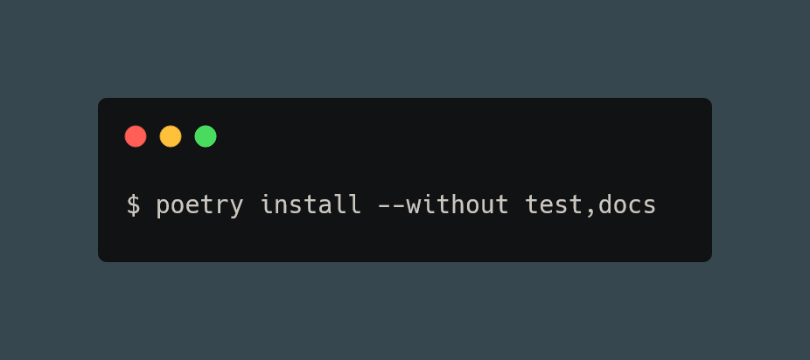
poetry install

Slide 29
poetry update
In order to get the latest versions of the dependencies and to update the poetry.lock file, you should use the update command.
This will resolve all dependencies of the project and write the exact versions into poetry.lock.

Slide 30
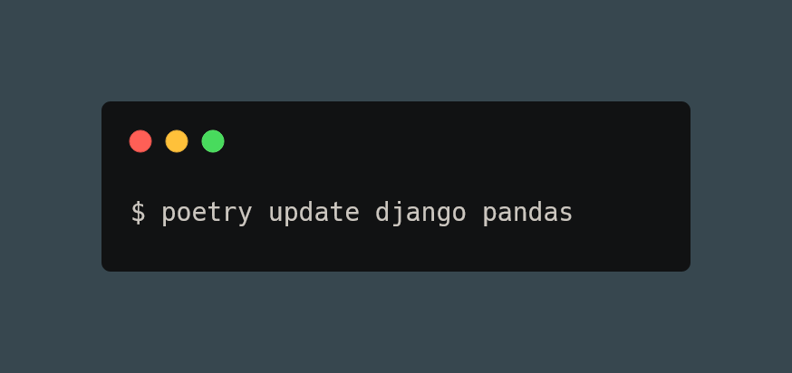
poetry update

Slide 31
poetry build
The build command builds the source and wheels archives.
Note that, at the moment, only pure python wheels are supported.
Python wheels are a pre-built binary package format for Python modules and libraries. They are designed to make it easier to install and manage Python packages, by providing a convenient, single-file format that can be downloaded and installed without the need to compile the package from source code.

Slide 32
poetry publish
This command publishes the package, previously built with the build command, to the remote repository.
It will automatically register the package before uploading if this is the first time it is submitted.

Slide 33
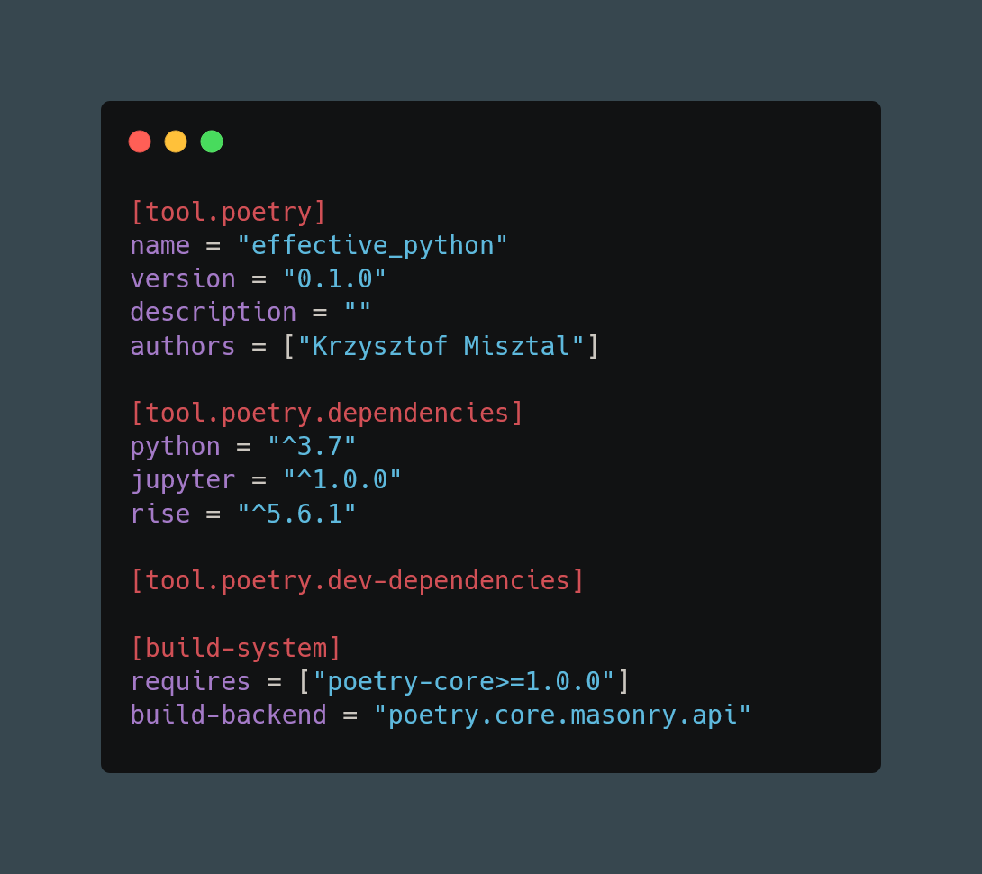

Slide 34
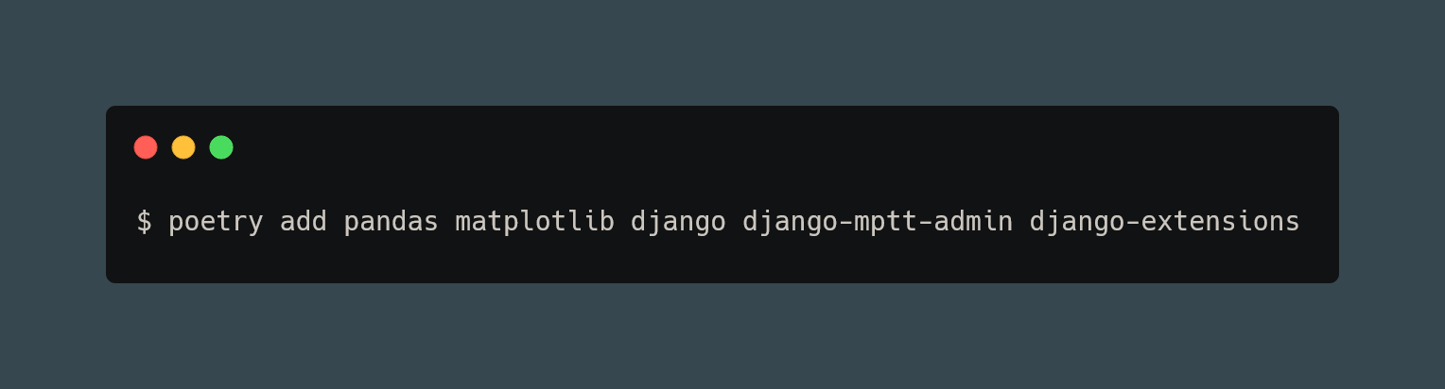

Slide 35
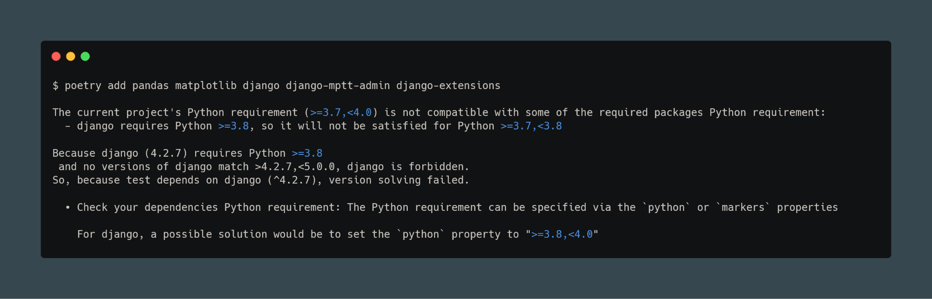

Slide 36
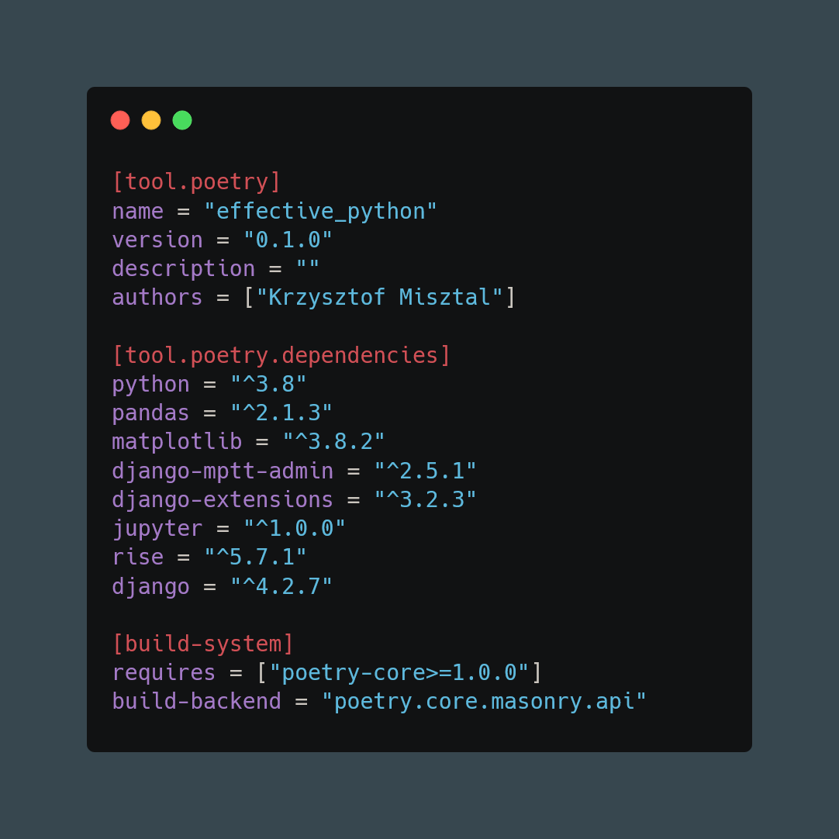

Slide 37
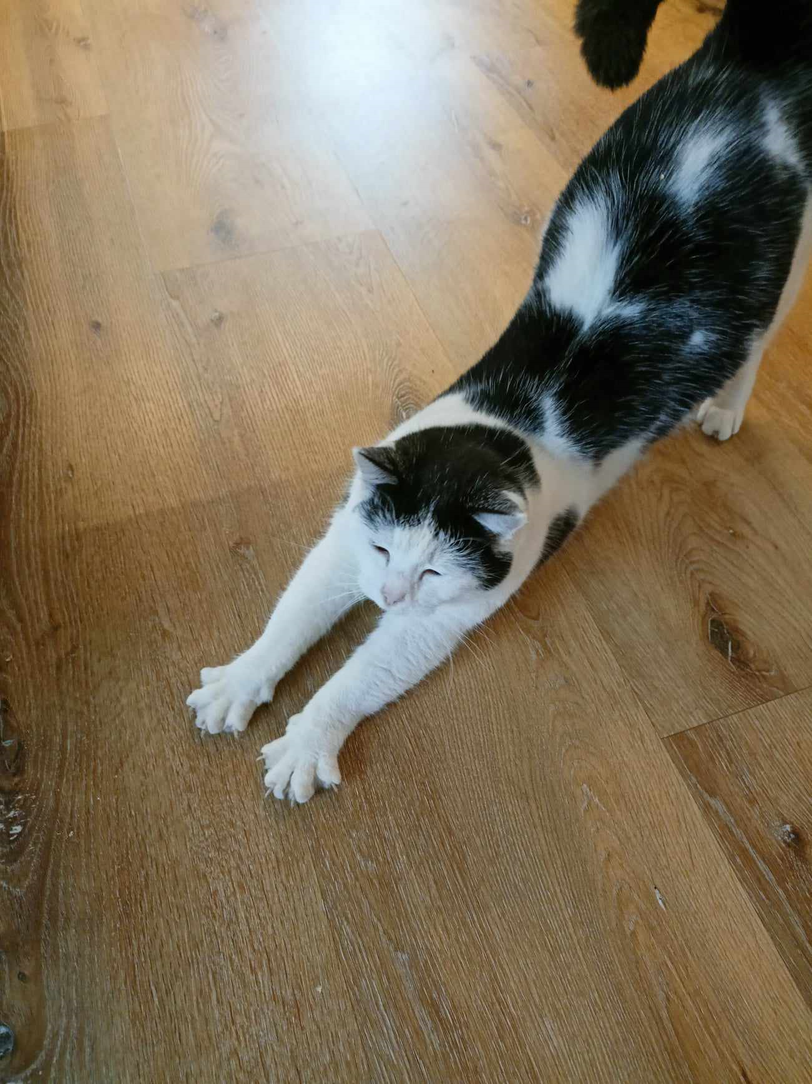
Thanks

